Slide 1
Secure Data Hiding in Images Using Steganography
Cybersecurity PROJECT
Presented By: MARK ALFRED JUDE NAZARETH
Student Name : MARK ALFRED JUDE NAZARETH
College Name & Department : FR. CONCEICAO RODRIGUES COLLEGE OF ENGINEERING, COMPUTER ENGINEERING DEPT.

Slide 2
OUTLINE
Problem Statement
Technology used
Wow factor
End users
Result
Conclusion
Github Link
Future scope

Slide 3
PROBLEM STATEMENT
The challenge about this project is to ensure secure transmission of confidential data over an untrusted medium. Hence, the project employs steganography to hide secret messages within images, ensuring data remains confidential from unauthorized access. The security is further enhanced by utilizing an encryption algorithm and password protection. The project aims to enhance the privacy and security of sensitive information.

Slide 4
TECHNOLOGY USED
Programming Language: Python
Libraries:
OpenCV (cv2): For image processing
os: For interacting with the operating system
tkinter: For creating the graphical user interface (GUI)
Platform: Jupyter Notebook

Slide 5
WOW FACTORS
This project stands out due to its seamless integration of steganography with a user-friendly GUI. Unique features include:
Allows users to create and use a passcode for protection for enhanced security.
Separate encryption and decryption programs, providing flexibility and ease of use.
Capability to handle various image formats.
Interactive GUI that simplifies the encryption and decryption processes for end users.

Slide 6
END USERS
End Users:
Individuals needing to transmit sensitive data securely.
Organizations looking to protect confidential information using media.
Cybersecurity professionals interested in implementing and testing data hiding techniques.

Slide 7
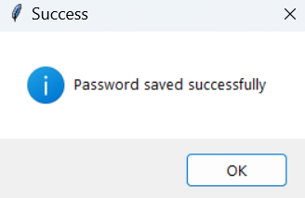
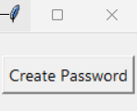
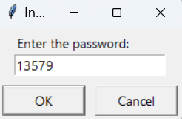
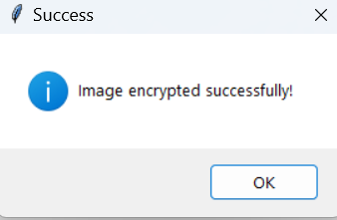
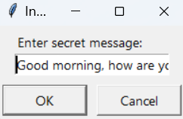
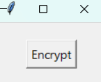
RESULTS (Password creation and encryption:)

Slide 8
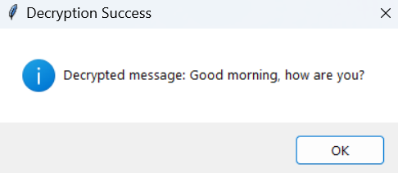
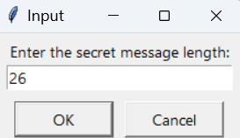
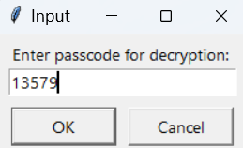
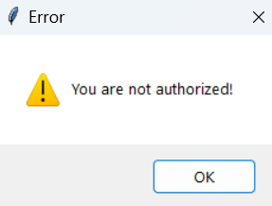
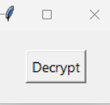
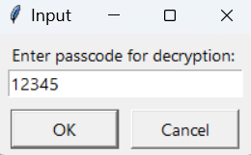
RESULTS (Decryption):

Slide 9
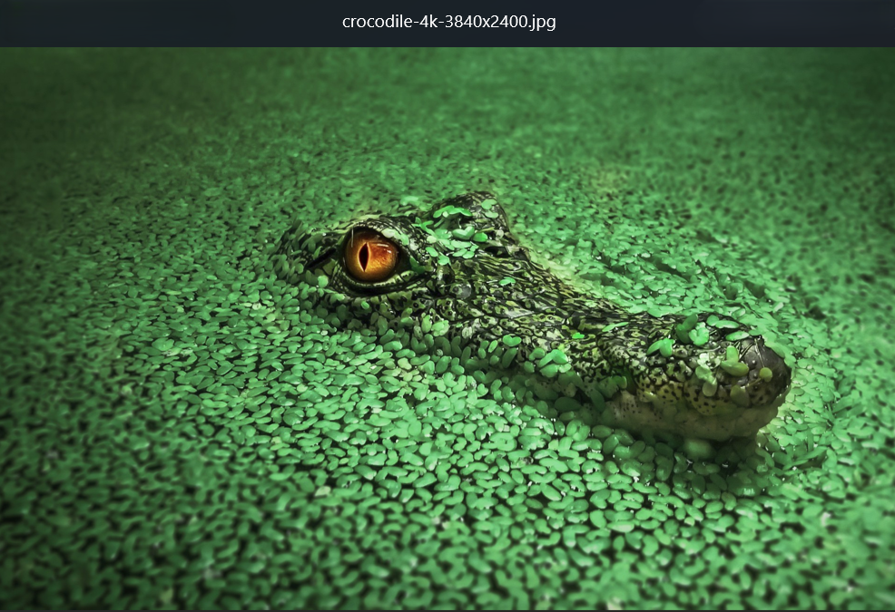
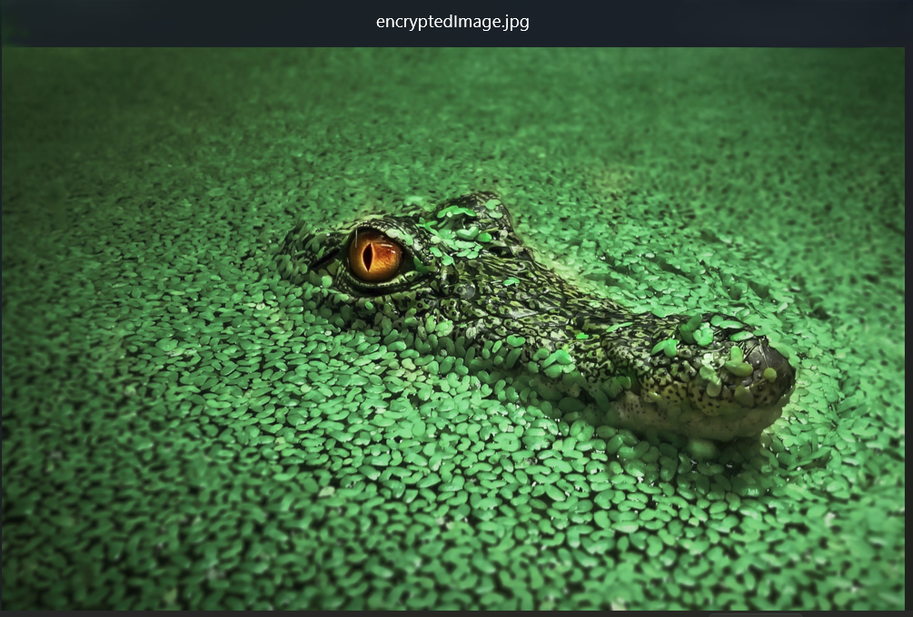
RESULTS (Images):
Original Image
Encrypted Image

Slide 10
CONCLUSION
The project successfully addresses the problem of secure data transmission by employing steganography to embed secret messages within images. By providing password protection and easy-to-use programs for both encryption and decryption, the project ensures that sensitive information remains hidden from unauthorized access. The use of Python and relevant libraries makes the implementation efficient and user-friendly.

Slide 11
GITHUB LINK
Link:
git@github.com:Markie47/Steganography-Project.git

Slide 12
FUTURE SCOPE(OPTIONAL)
Enhancing the algorithm to support larger message sizes without compromising image quality.
Implementing advanced encryption techniques to further increase security.

Slide 13
THANK YOU

